Slide 1


LAPTOP SALES DATA
ANALYSIS
PRESENTED BY:
ARUNKUMAR A

Slide 2
INTRODUCTION
  This project focuses on the analysis of laptop sales data to understand market trends, customer preferences, and sales performance across different brands and specifications
  Customers facing difficulty to choosing the right laptop due to the overwhelming options, while manufactures and retailers struggle to optimize pricing and features to remain competitive.

Slide 3
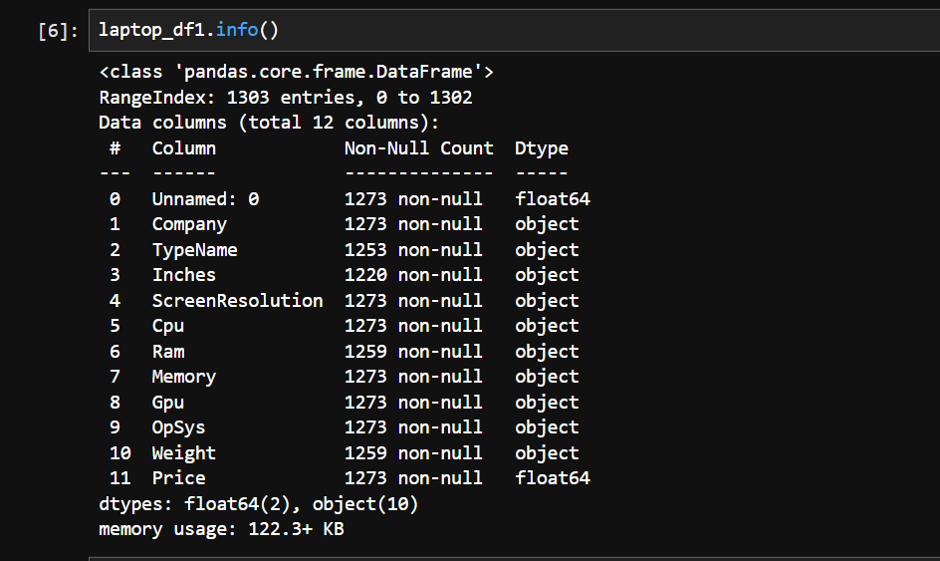
DATA UNDERSTANING
  DATA DIMENSIONS – 1303 ROWS & 12 COLUMNS
  Checking Datatypes , proper formatting, Relevant columns for analysis.
-

Slide 4
DATA CLEANING
  Fixing Rows and Columns
  Check missing values
  Check outliers
  Fix outliers
  Dropped column ‘Unnamed: 0’.
  Check the unique values in columns (Inches, Ram, Weight, Price)
  Numerical columns fill with median
  Categorical columns fill with mode.

Slide 5
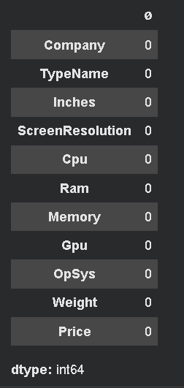
CHECK MISSING VALUES
There is no missing values in the dataset.
There is no missing values in the dataset.
There is no missing values in the dataset.

Slide 6
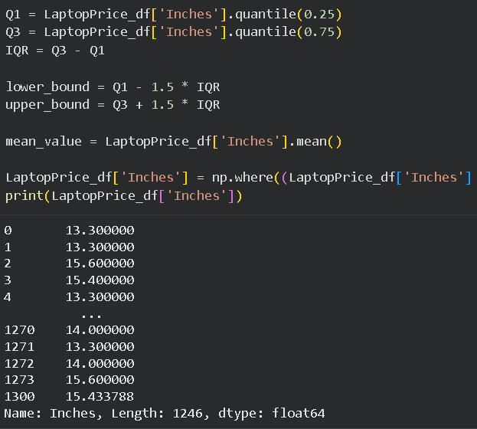
OUTLIERS
  The column Inches seems to have outliers.

Slide 7
STATISTICAL ANALYSIS
AAA
The statistical analysis of laptop sales data was conducted using key descriptive measures such as mean, median, mode, minimum, maximum, and standard deviation
Overall, the statistical results provide a clear numerical summary of sales performance and market trends.

Slide 8
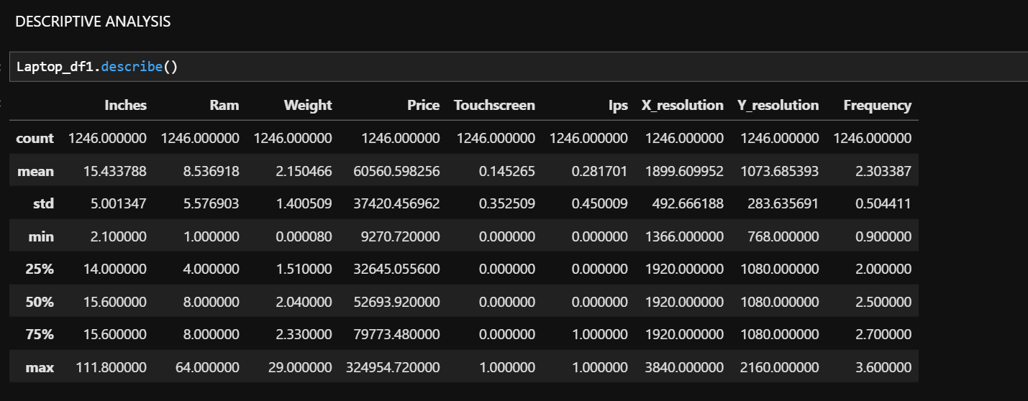
DESCRIPTIVE ANALYSIS

Slide 9
TYPE OF USING STATISTICAL TESTS.
  One Sample T-test
  Laptop price differ from the population mean of 70,000.
  Chi – Square Test
  Independence between Laptop company and Laptop type name.
  Two Sample Z – Test
  Test If the Average Laptop price is different between two companies of Dell and HP.

Slide 10
DATA VISUALIZATION
  Data visualization was used to represent laptop sales data in a clear and meaningful way using charts and graphs such as pie chart, bar charts etc..

Slide 11
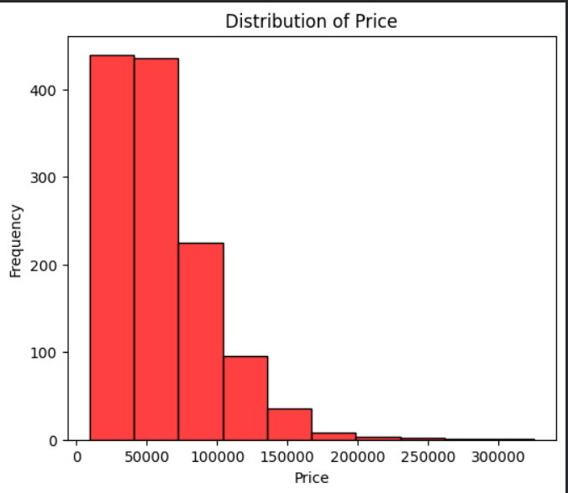
UNIVARIATE ANALYSIS
  By using Histogram plot shows the spread of price
  High sailed Laptops are between 0 to 1 lakh.
  Low sailed laptops are between 2 lakhs to 3 lakhs .
  By using count plot.
  Lenovo, Dell and HP is highly sailed laptops.
  Lowest sailed laptop is Apple.

Slide 12
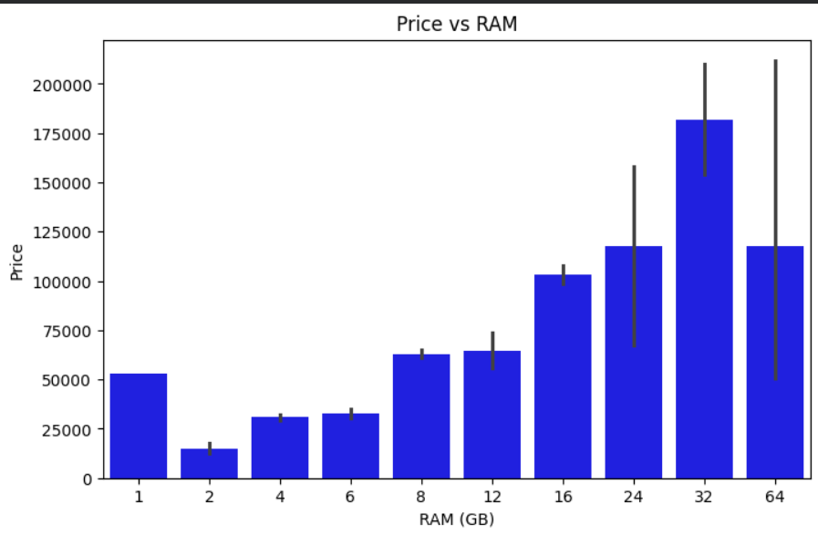
BIVARIATE ANALYSIS
  By using Bar plot , it shows ram wise Price.
  Highly sailed laptops are 32GB Ram .
  Lowest sailed laptops are 2GB Ram.

Slide 13
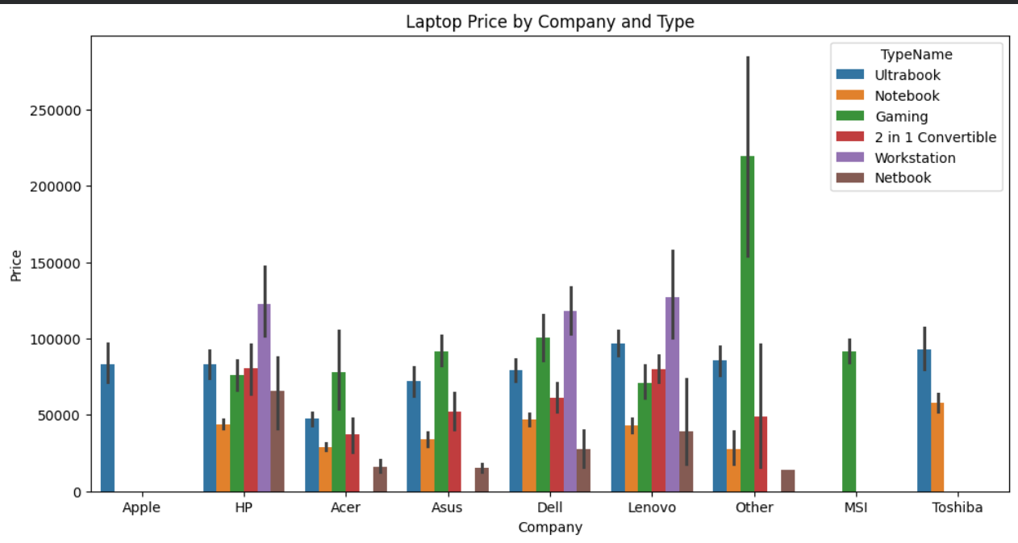
MULTIVARIATE ANALYSIS
  In this plot other company sailed the most number of gaming laptops in high price.
  Notebook laptops are sailed very low to compare all companies.

Slide 14
RECOMMENDATION
  Based on the data analysis, gaming laptops, 32 GB RAM laptops, and Windows 10-based laptops are identified as the most sold and highly preferred by customers. It is recommended that manufacturers and sellers focus more on these configurations to maximize sales and customer satisfaction.

Slide 15
THANK YOU

